Slide 1

Welcome!

Slide 2
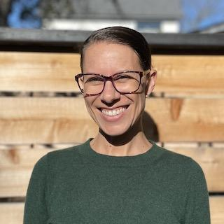
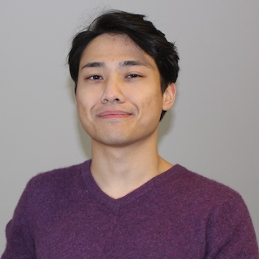
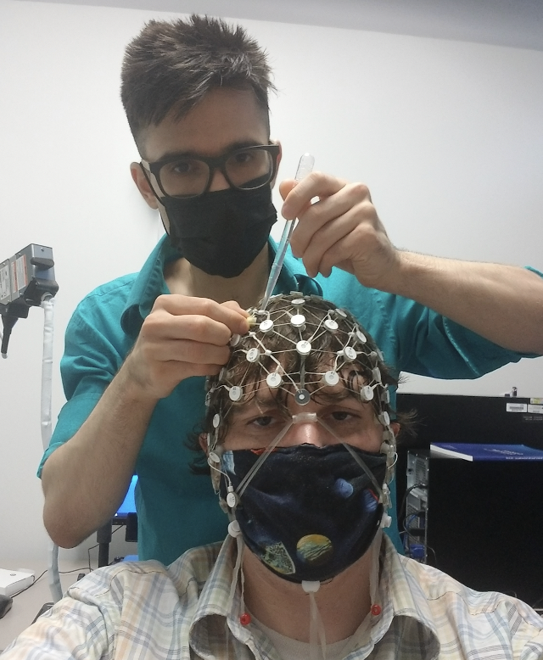
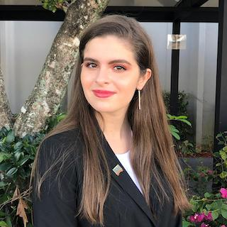
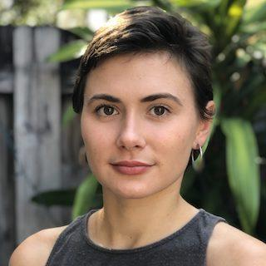
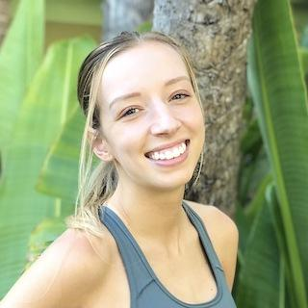
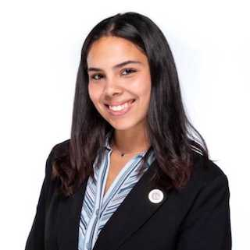
Thank you
All of YOU!
Jess
Farukh
Panos
Emily
Arina
Sarah
Ana

Slide 3
Overview of the next three days
Each day consists of trainings in EEG (AM) and non-EEG topics (PM)
We have additional members of FIU community joining for the EEG trainings
Mix of lectures, demos, and hands-on experiences
Everything is being recorded, all materials are publicly available

Slide 4

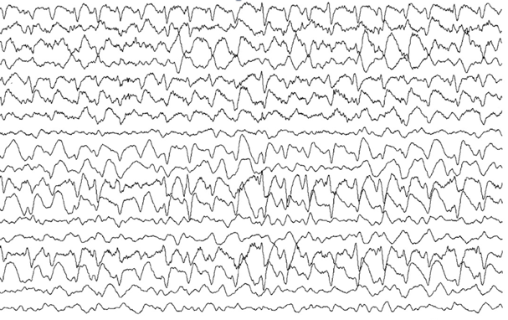
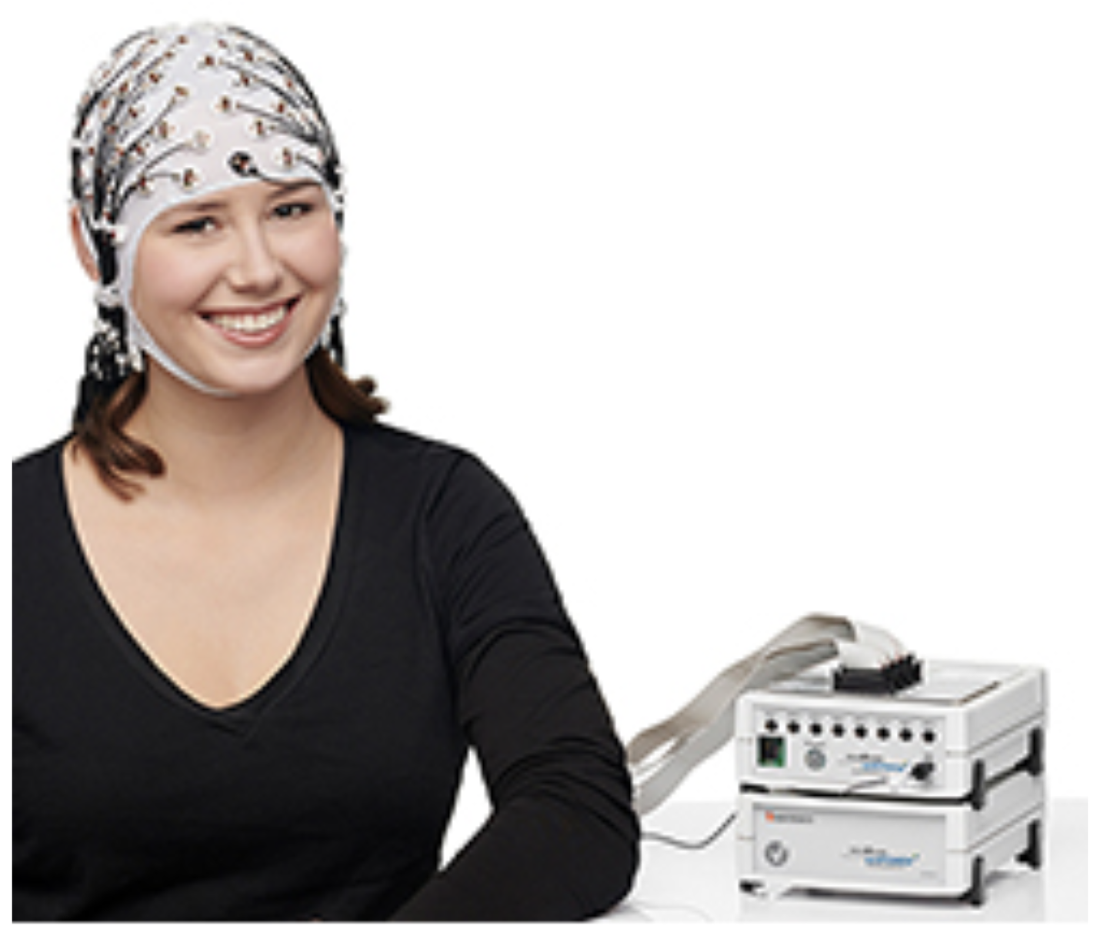
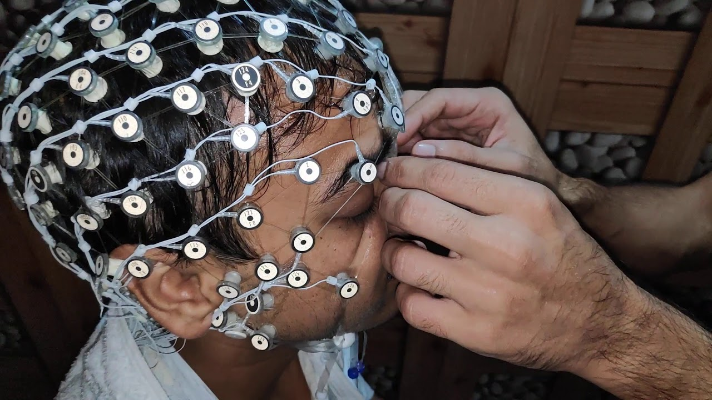
EEG Learning goals
Learn what EEG is, where it comes from, and what it is used for
General principles of high-quality EEG data collection
How to use specific EEG system(s) to collect data here at FIU

Slide 5


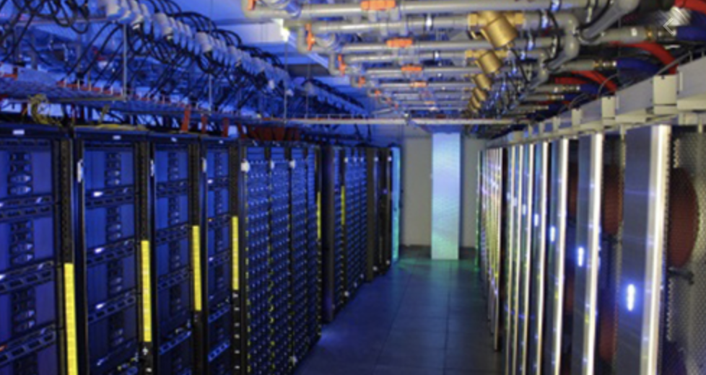
Non-EEG learning goals
Introduce you to the NDCLab culture, who we are, and what we do
Introduce you to GitHub and how we use it in the NDCLab
Introduce you to the HPC and how we use it in the NDCLab

Slide 6
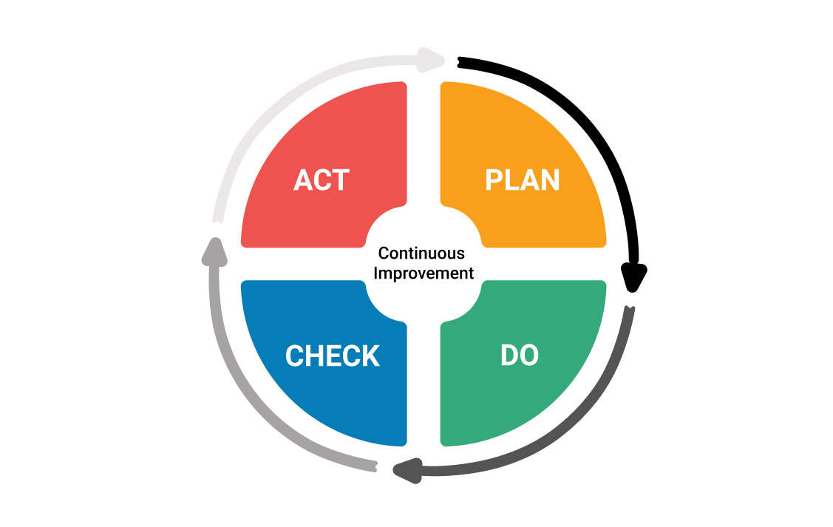

Continuous improvement
These trainings are a work in progress
We plan to put together formal protocols and videos (published to the protocol exchange) in the coming year
YOU ALL will help to put together a formal version of these trainings (and be listed as authors on the protocol exchange publications)
Protocols can be cited and contribute to your h-index!

Slide 7
Schedule
Thursday
9-12: EEG
9-10:30: Lecture on “Collecting and monitoring EEG”
10:30-10:40: Break
10:40-12: Demo “EGI data collection” 12-1: Lunch 1-3 (PhD Students Only): FIU Information Session 1-1:45: Intro to Python 1:45-2:45 HPC Overview
2:45-3: Break 3-4: GitHub Etiquette
Wednesday
9-9:15: Welcome 9:15-11:30: EEG
9:15-10:50: Lecture on “EEG basics”
10:50-11: Break
11-11:30: Lecture on “Our EEG systems” 11:30-12: Lab Photo 12-1: Lunch (optional headshots 12-12:30) 1-2: Lab Culture
2-2:30: Tour of data collection rooms in AHC5 2:30-2:45: Break 2:45-4: GitHub Team Power-up!
Friday
9-10: Hands-on identification/troubleshooting artifacts 10-1 (PhD Students Only): Orientation Session 10-12: Hands-on EEG capping practice 12:15-1: Lunch 1-2:45: Git-a-thon! 2:45-3: Break 3-4: Presentation on “Looking back and looking ahead from the NDCLab’s first year”

Slide 8
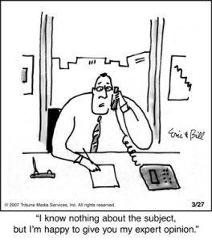
Before we get started…
Remember that it takes time to build expertise
Remember that you have to get out of your comfort zone to learn something new
My expertise in cognitive neuroscience did not come easily
But I was motivated…

Slide 9
Questions?
Next up: EEG Basics

